Slide 1
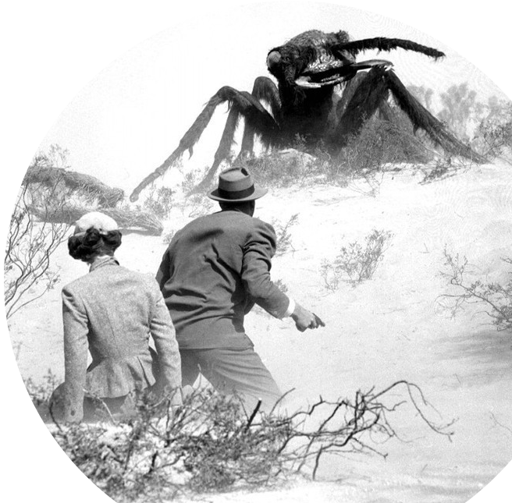
Prof. Darrell Long
CSE13
Stacks and Queues
1

Slide 2
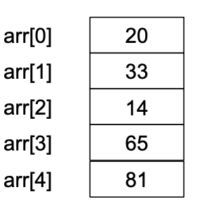
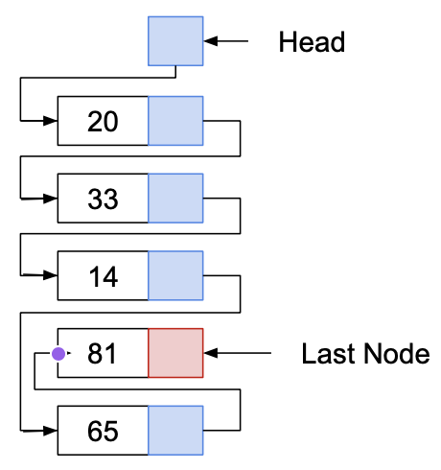
Arrays
Linked Lists
Arrays allow random access:
Each element can be accessed directly in constant time.
Linked lists allow sequential access:
Each element can only be accessed in a particular order.

Slide 3

Stacks and Queues
Operate as containers for other data types.
For the most part, data of any type may be placed in a stack or a queue.
Both have:
Well-defined semantics
A fixed set of operations
A distinct ordering to their elements

Slide 4
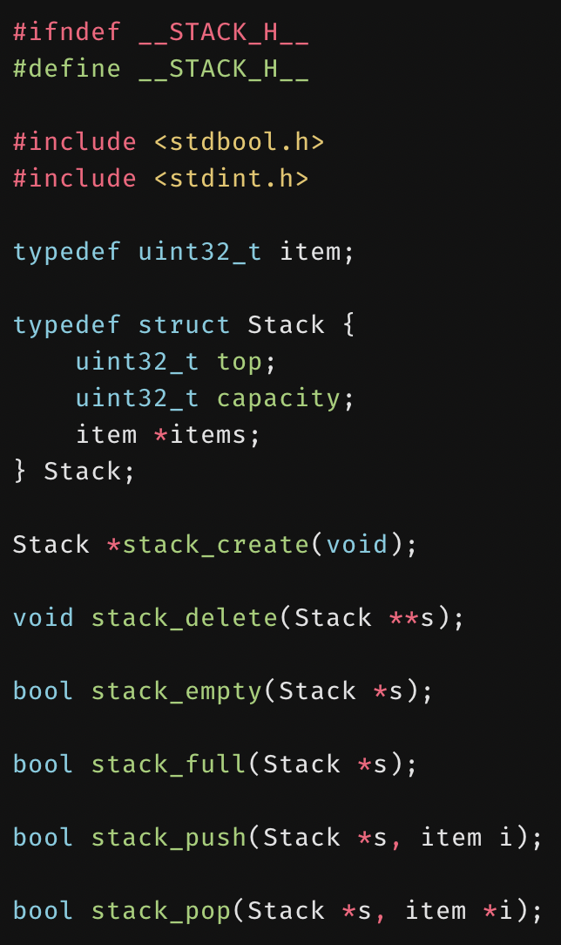
Stacks
Objects are added and removed using last-in-first-out (LIFO) order.
Capacity of a stack is the number of stack elements that will fit.
This capacity can be increased as number of elements increases through reallocation (dynamic).
Often implemented with arrays, but other possibilities exist as long as the semantics are preserved.
© 2020 Darrell Long

Slide 5
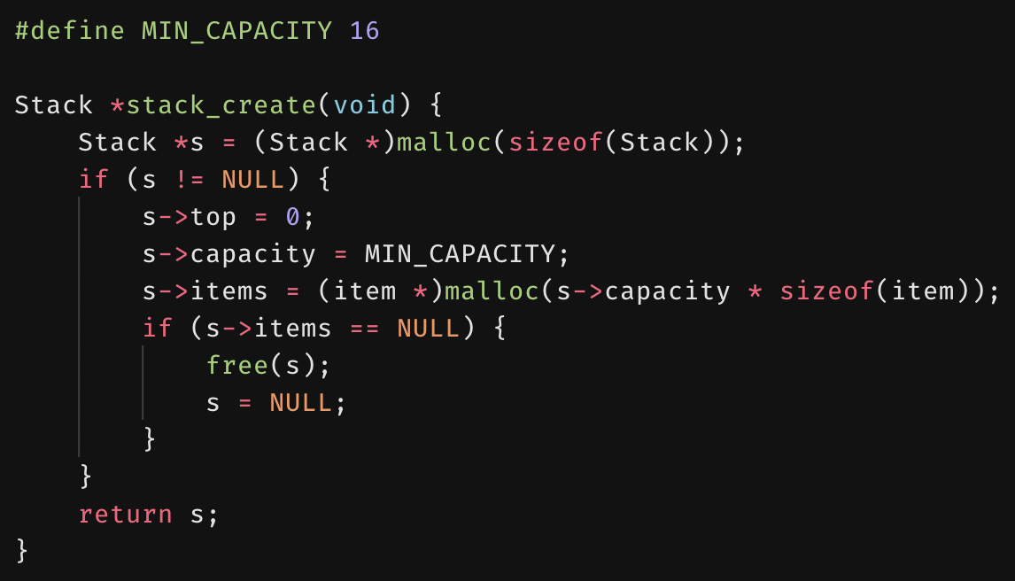
stack_create()
© 2020 Darrell Long

Slide 6
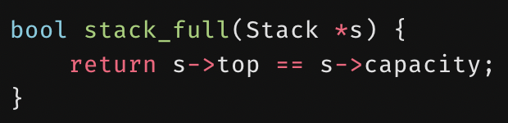
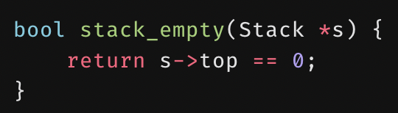
stack_full()
stack_empty()
© 2020 Darrell Long

Slide 7
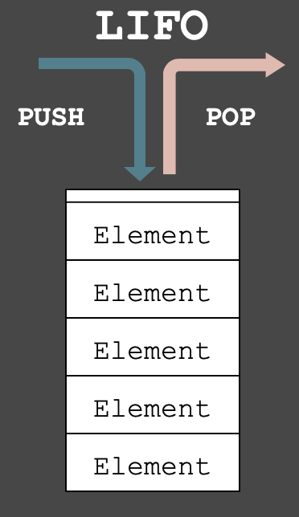
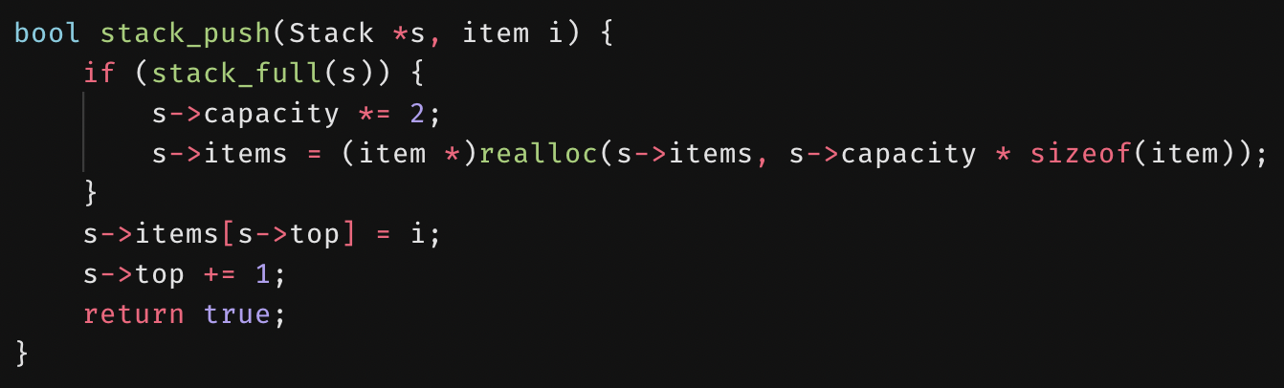
stack_push()
Adds an element to the top of a stack.
Example is for a dynamic stack, in which memory is reallocated when the stack is “full”.

Slide 8
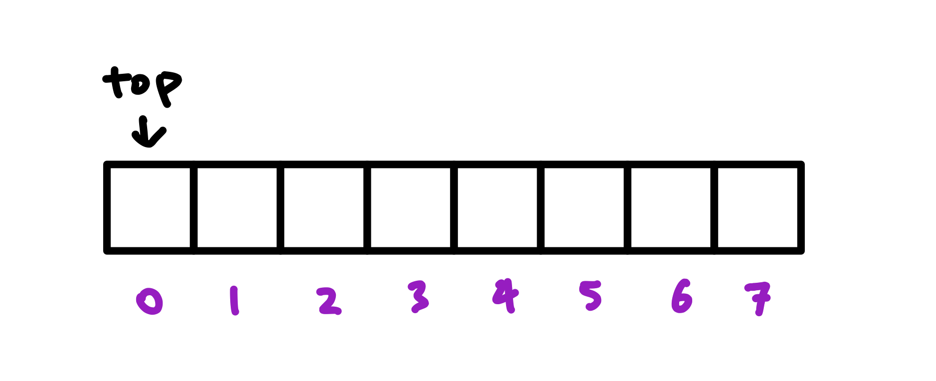
Example: Pushing items onto a stack
The top of the stack is the index of the next available spot.

Slide 9
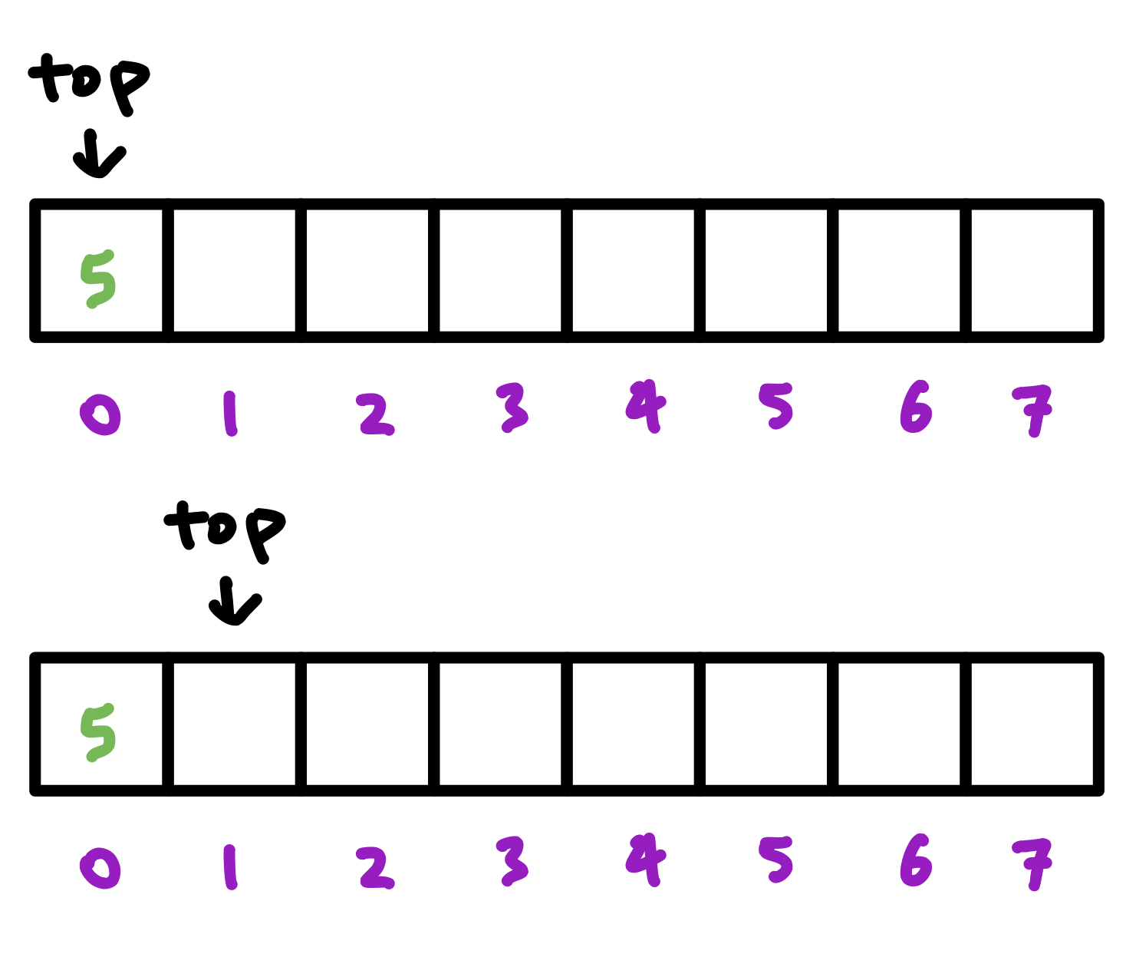
Example: Pushing items onto a stack
Assign the value, move the top forward.

Slide 10
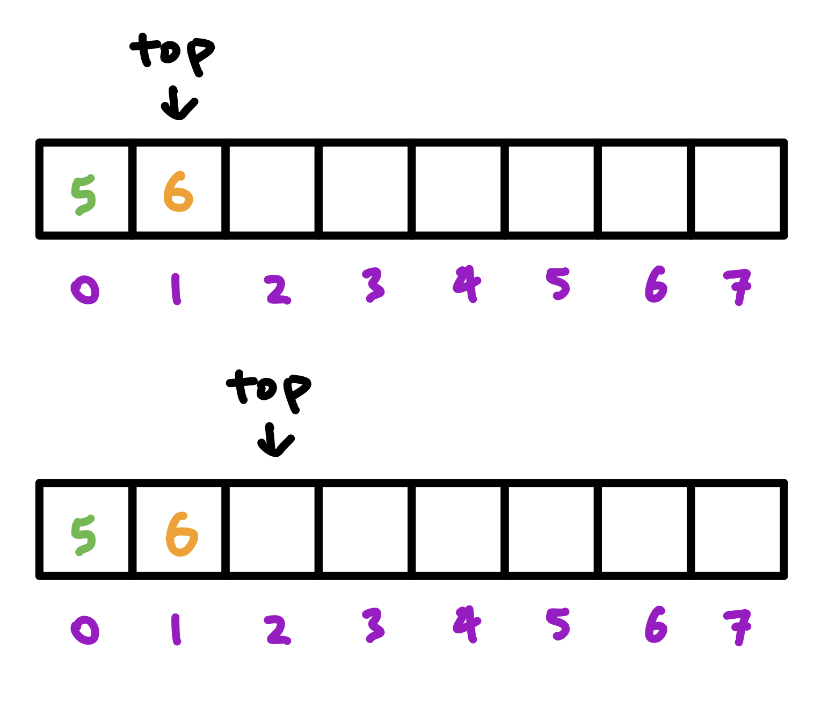
Example: Pushing items onto a stack
Assign the value, move the top forward.

Slide 11
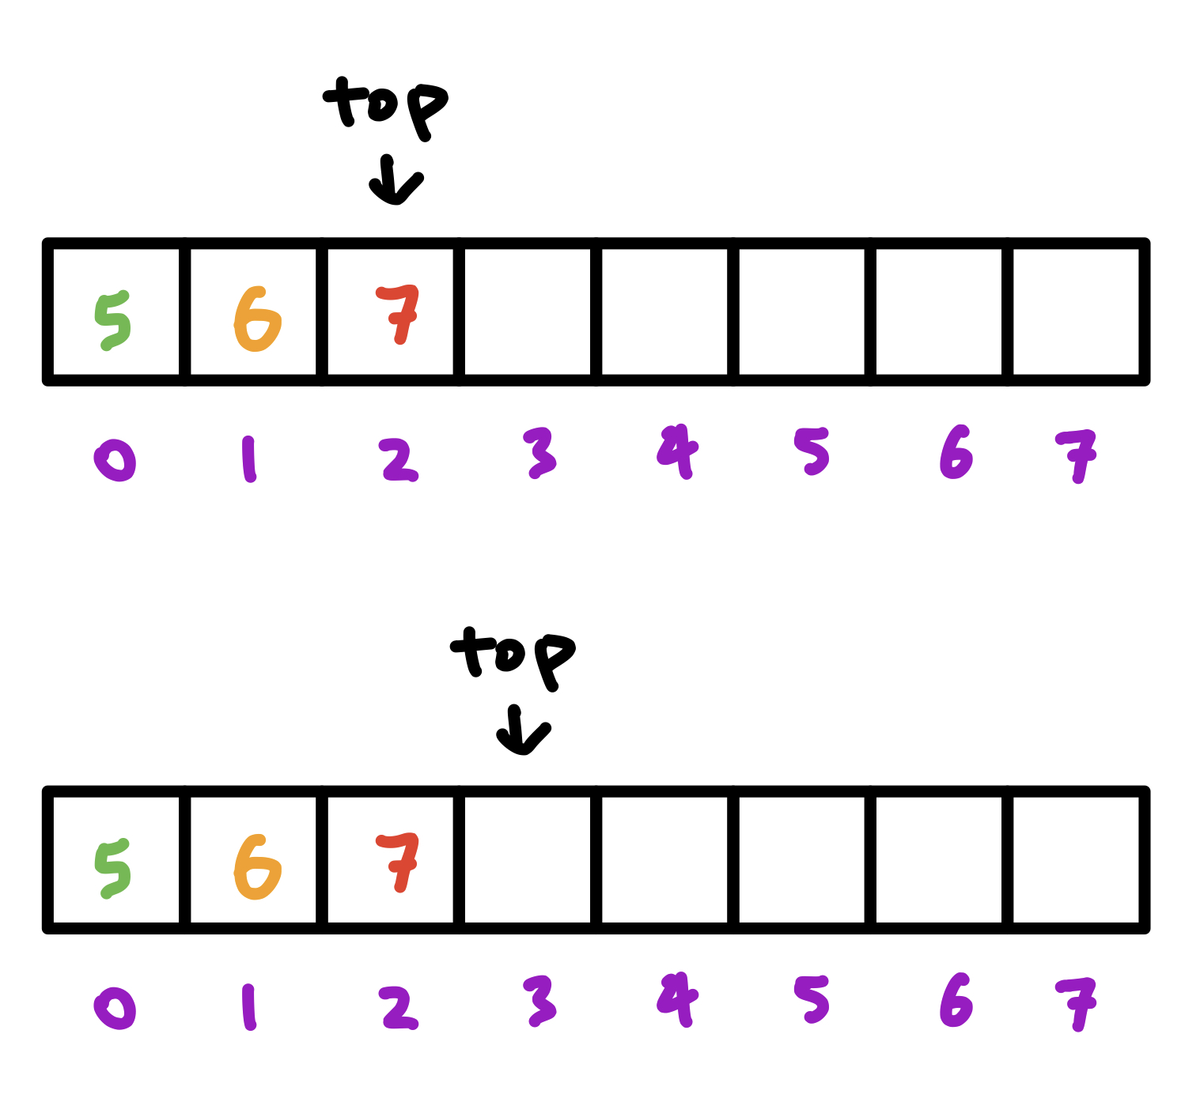
Example: Pushing items onto a stack
Assign the value, move the top forward.

Slide 12
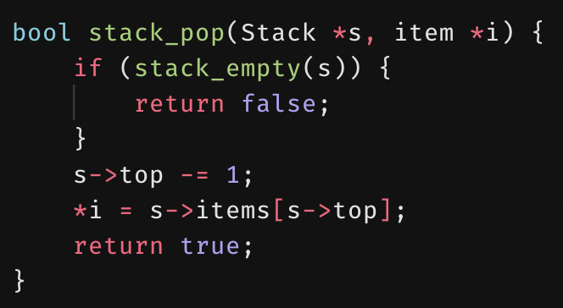
stack_pop()
Removes the element at the top of a stack.
Returns false if the stack is empty.

Slide 13
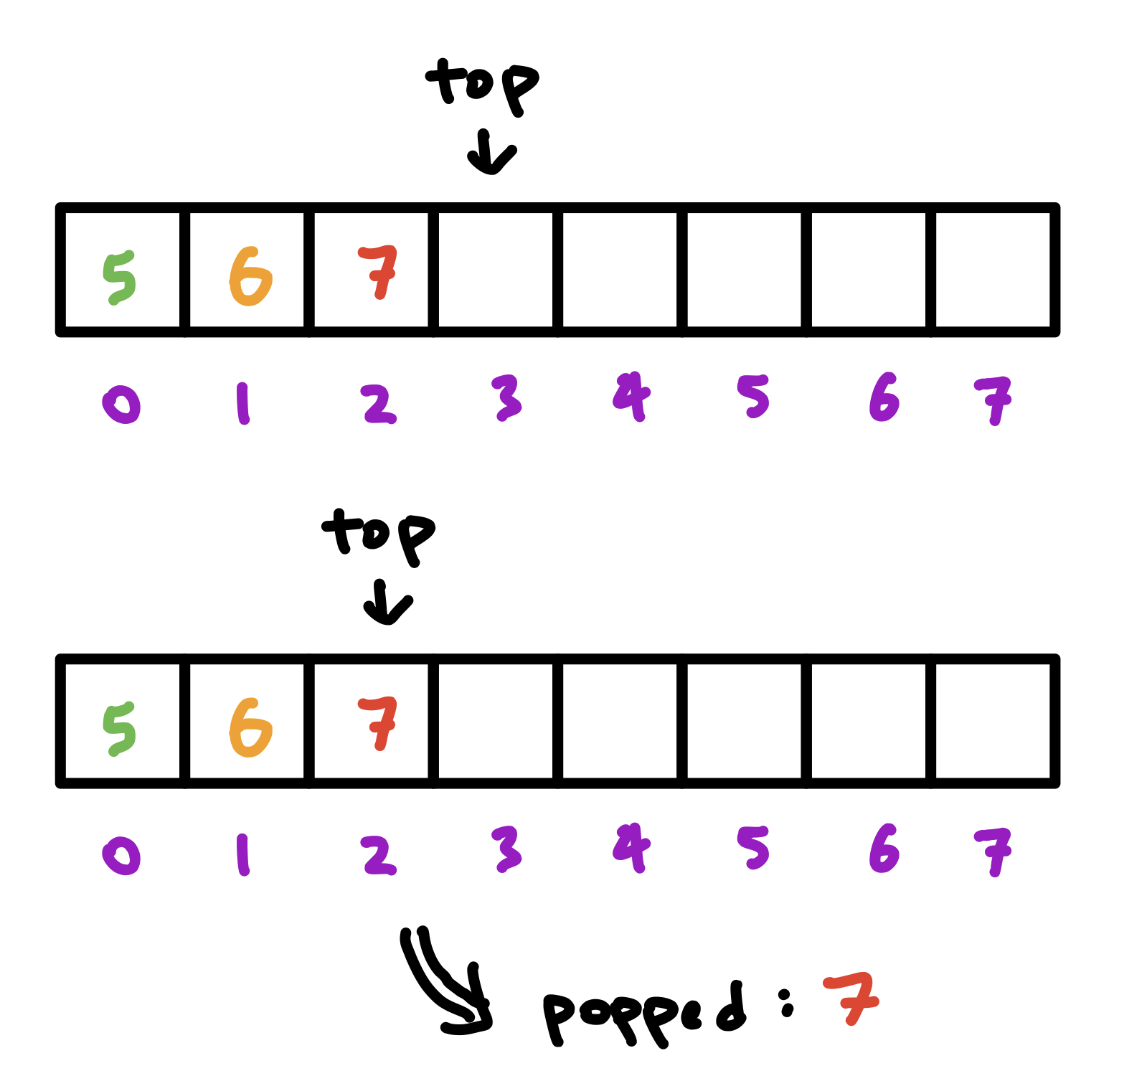
Example: Popping items off a stack
Move the top back, pass back the value.

Slide 14
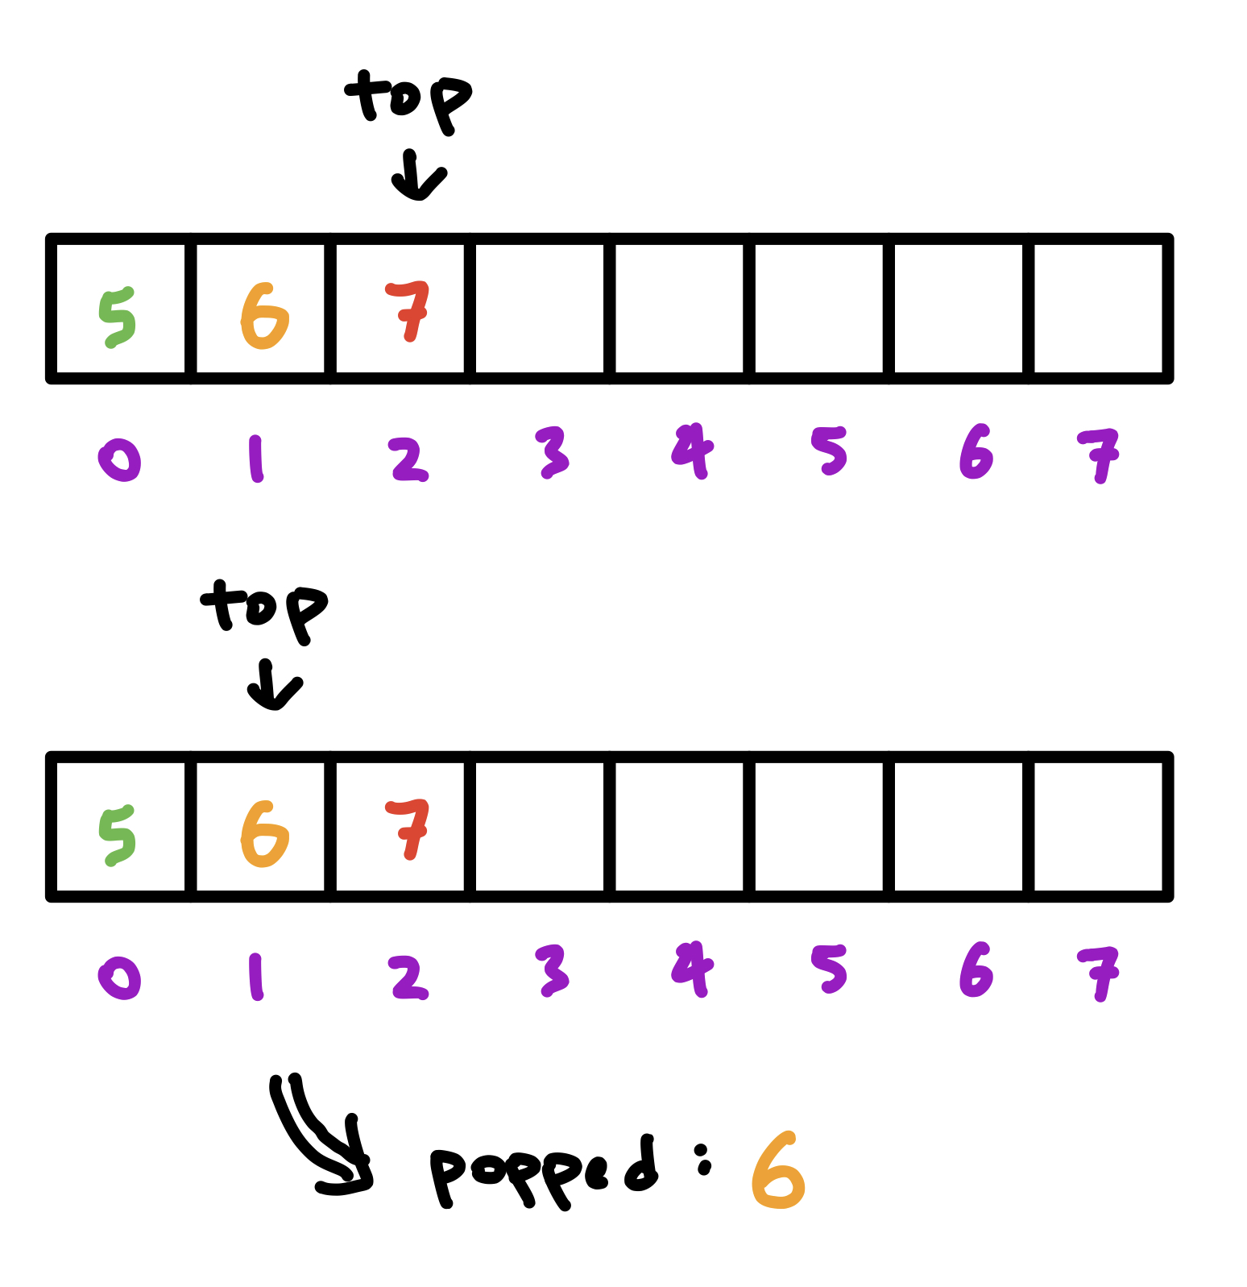
Example: Popping items off a stack
Move the top back, pass back the value.

Slide 15
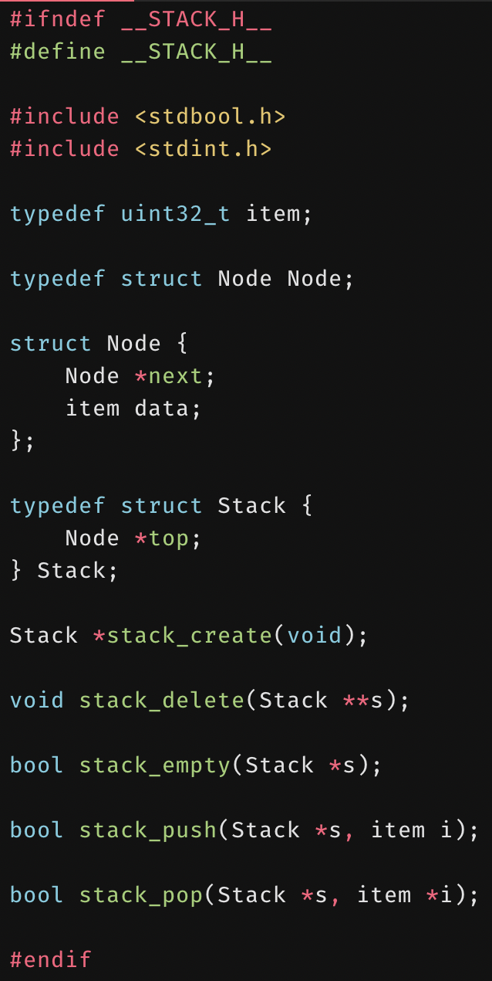
Stacks using linked lists
Stacks can also be implemented using linked lists.
Each element of the stack points to the next.
© 2020 Darrell Long

Slide 16
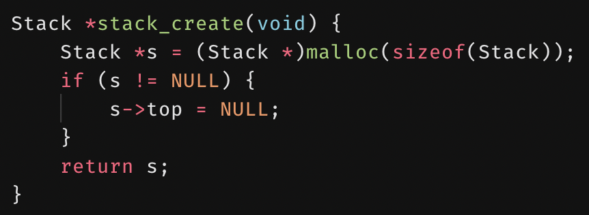
stack_create()
© 2020 Darrell Long

Slide 17
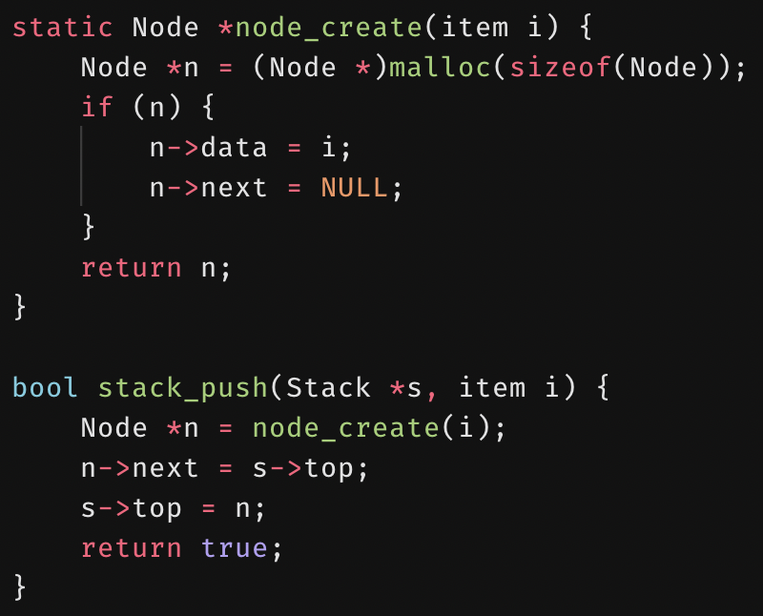
stack_push()
© 2020 Darrell Long

Slide 18
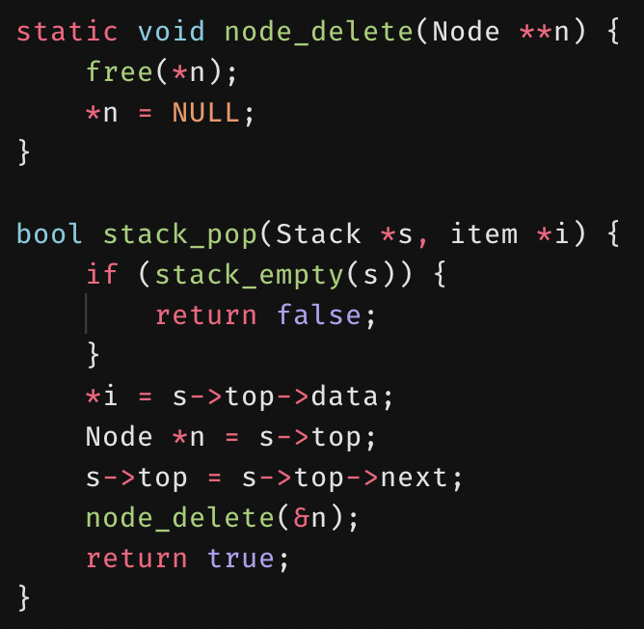
stack_pop()
© 2020 Darrell Long

Slide 19
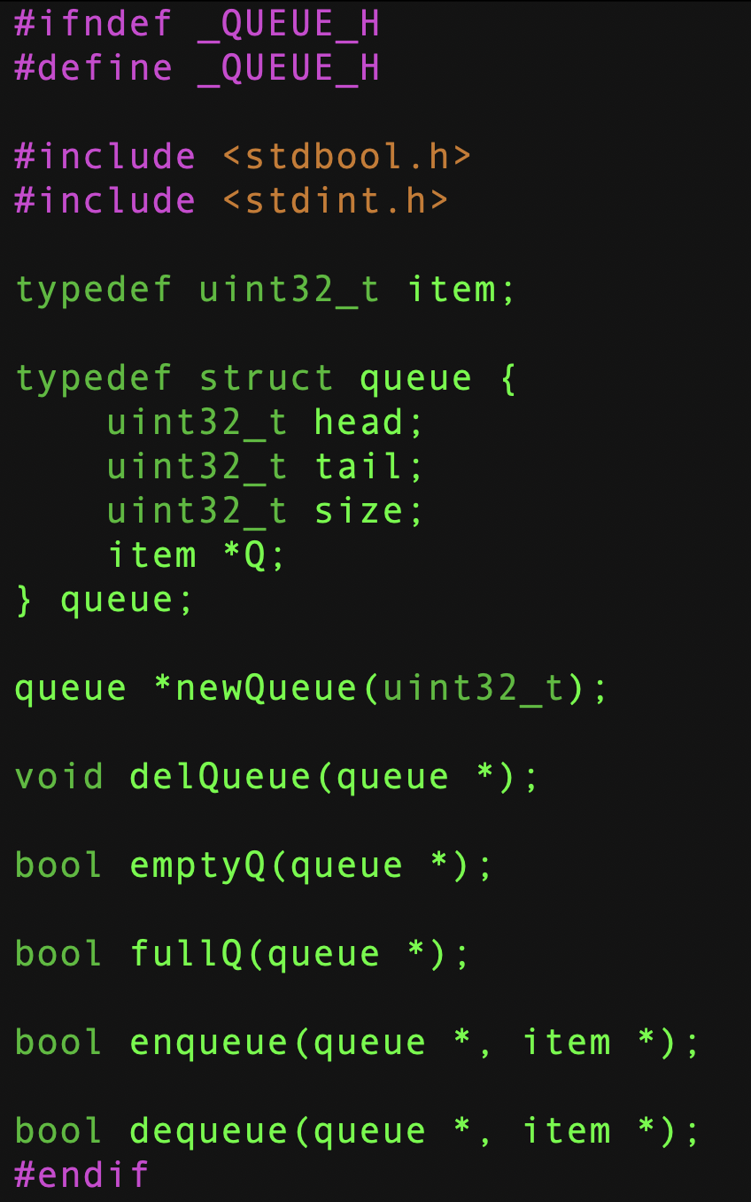
queue.h
A queue is an abstract data type (ADT), so let’s define it.
For our implementation we need:
A head, a tail, and a size, and
A pointer to an array.
A constructor
A destructor
Empty and full predicates
Enqueue — inserts into the queue
Dequeue — removes from the queue

Slide 20
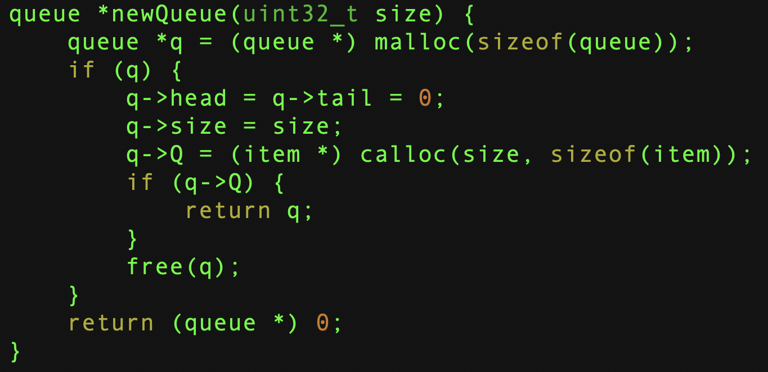
Create a Queue

Slide 21
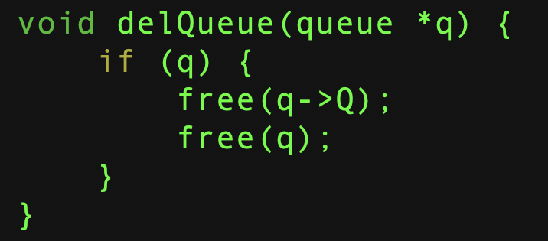
Delete a Queue

Slide 22
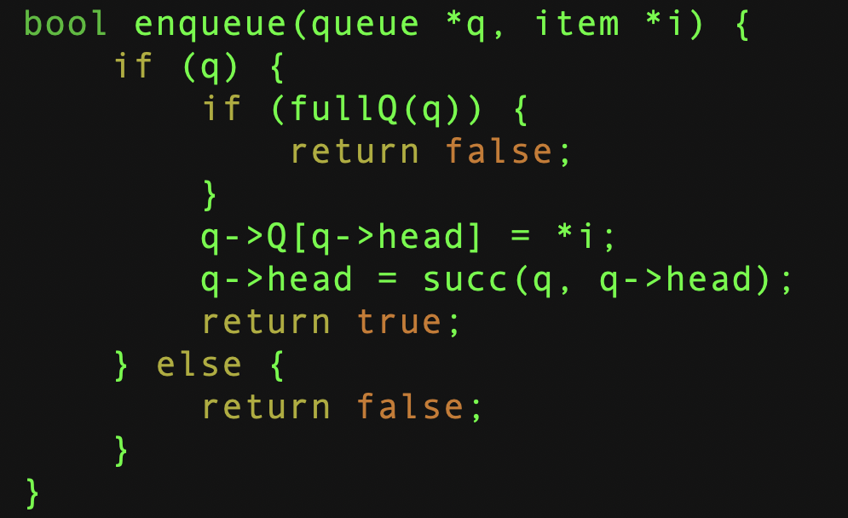
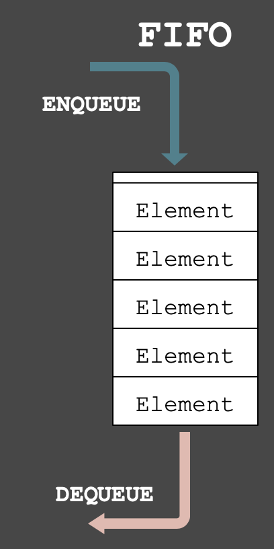
Enqueue an Item

Slide 23
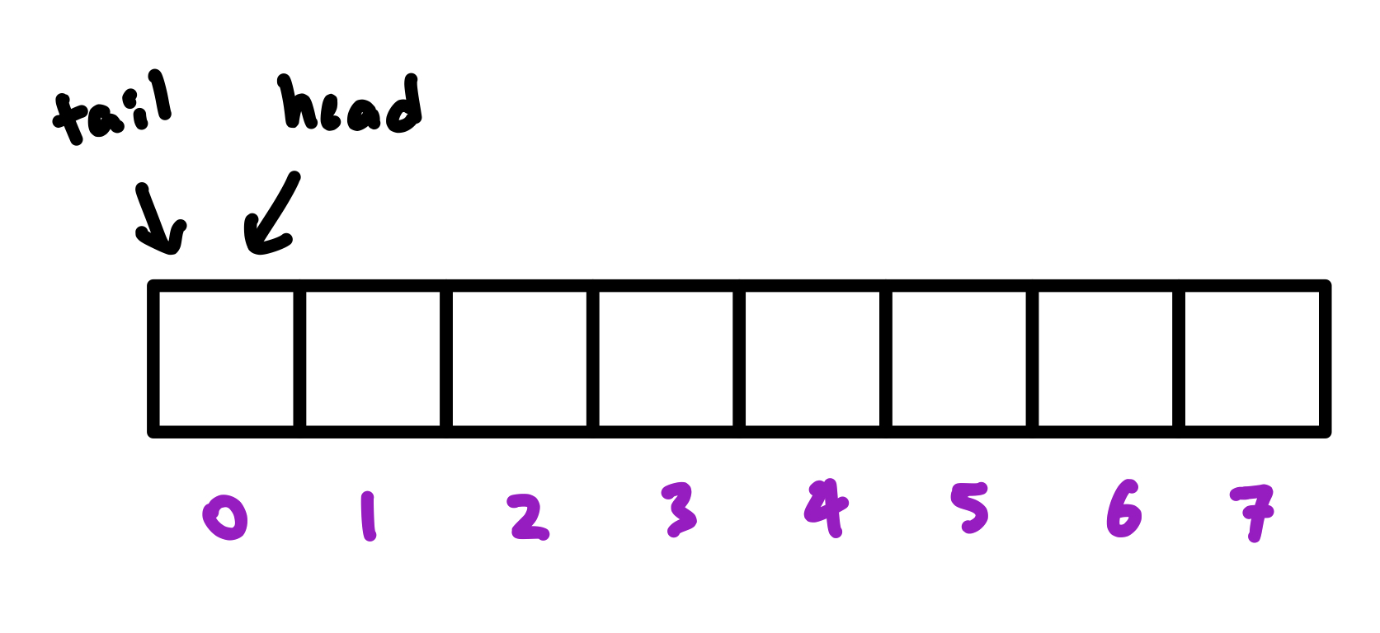
Example: Enqueuing items
The head is the index of the next available spot.
The tail is the index of the item to dequeue.
You can change these around.

Slide 24
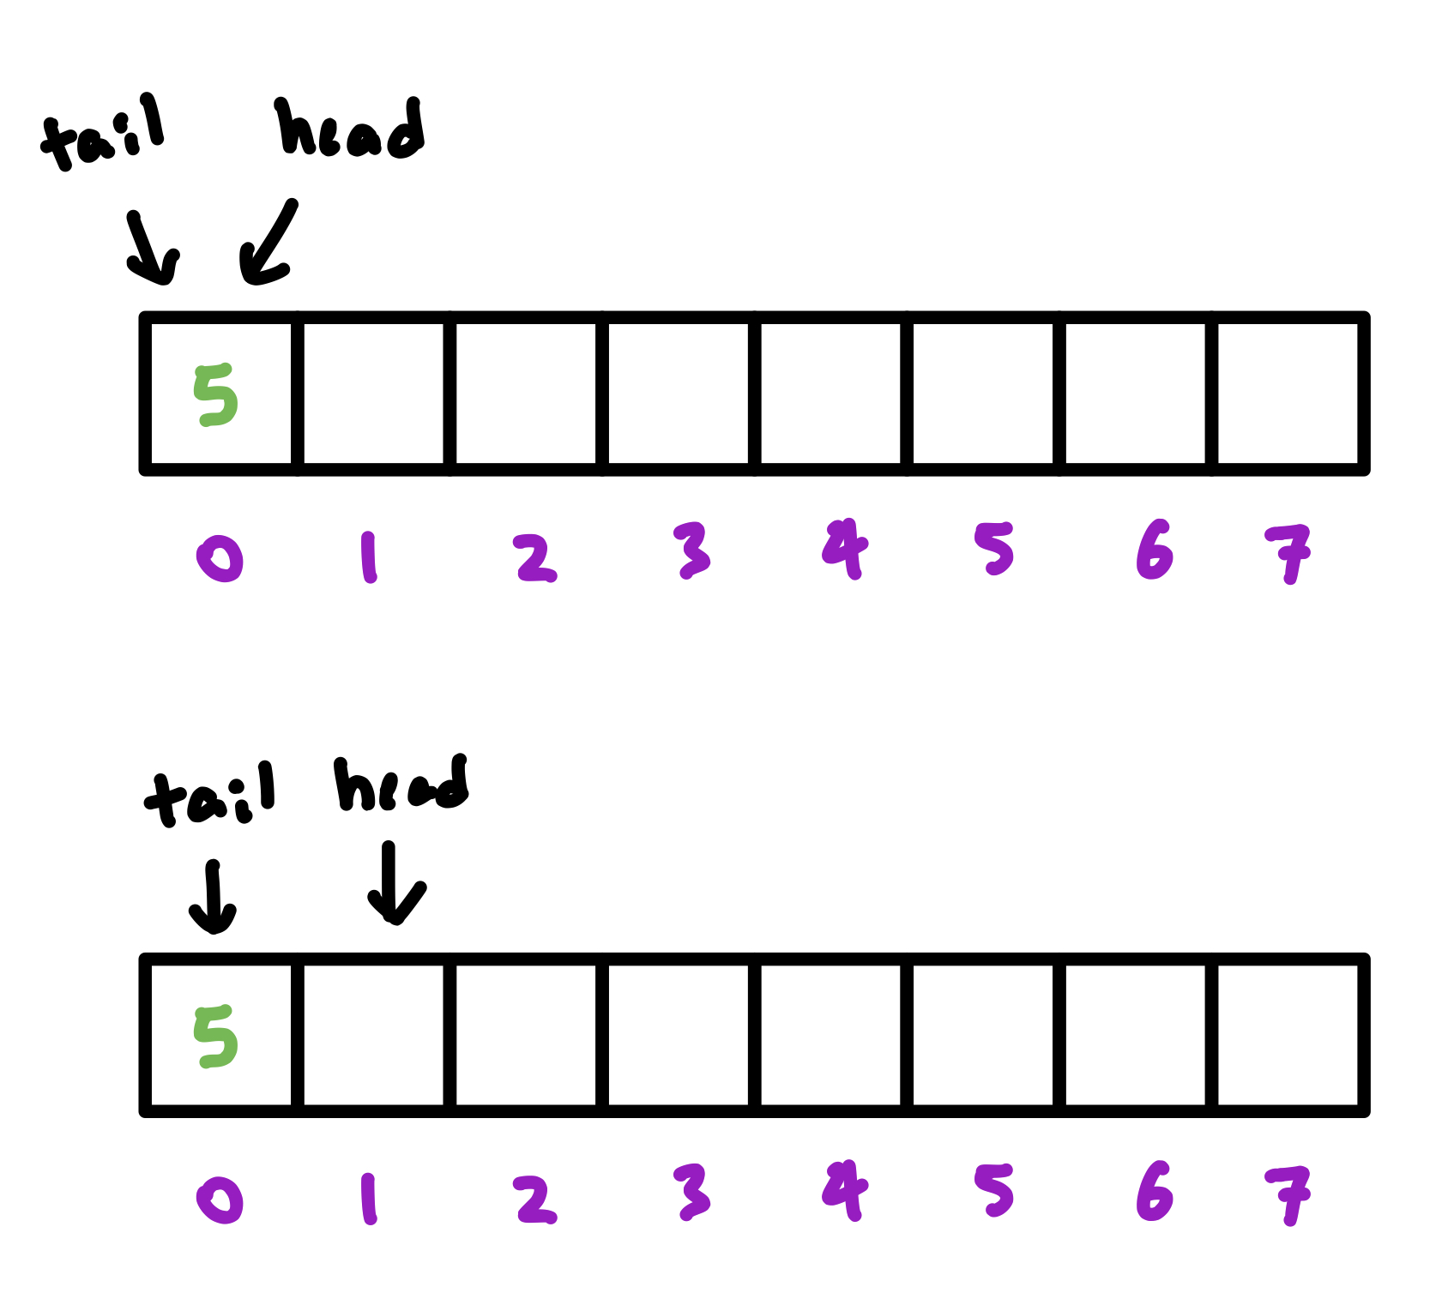
Example: Enqueuing items
Insert at the head, move the head forward.

Slide 25
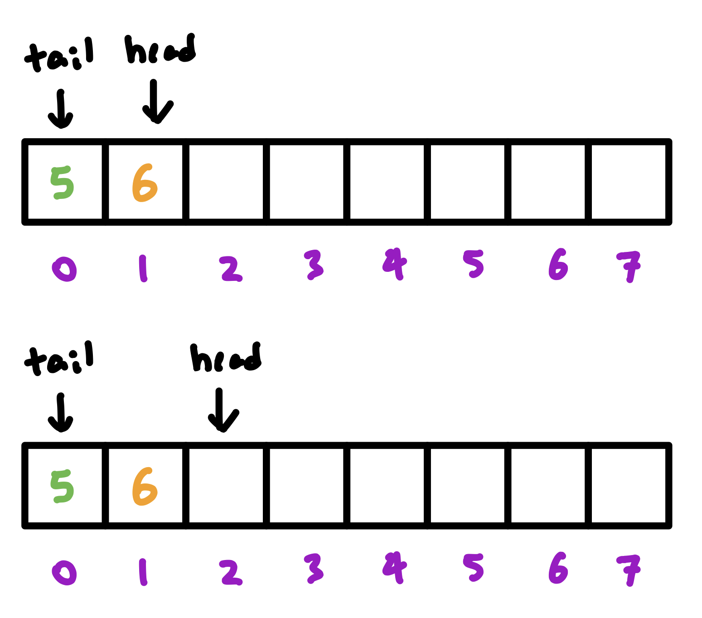
Example: Enqueuing items
Insert at the head, move the head forward.

Slide 26
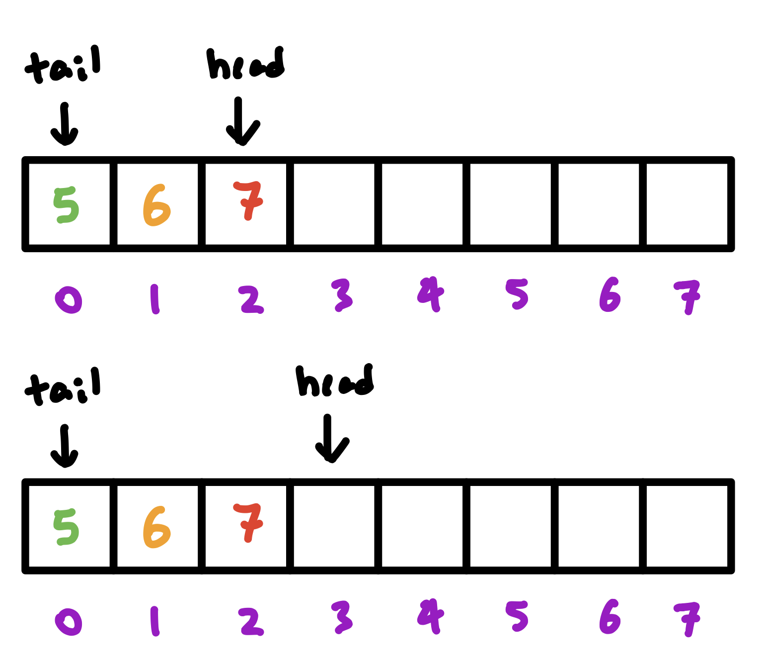
Example: Enqueuing items
Insert at the head, move the head forward.

Slide 27
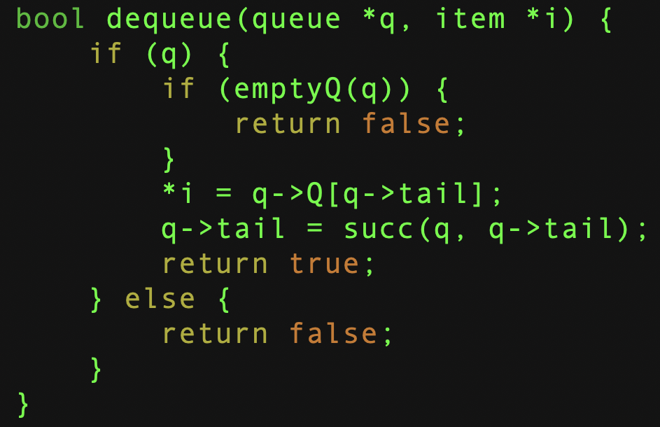
Dequeue an Item

Slide 28
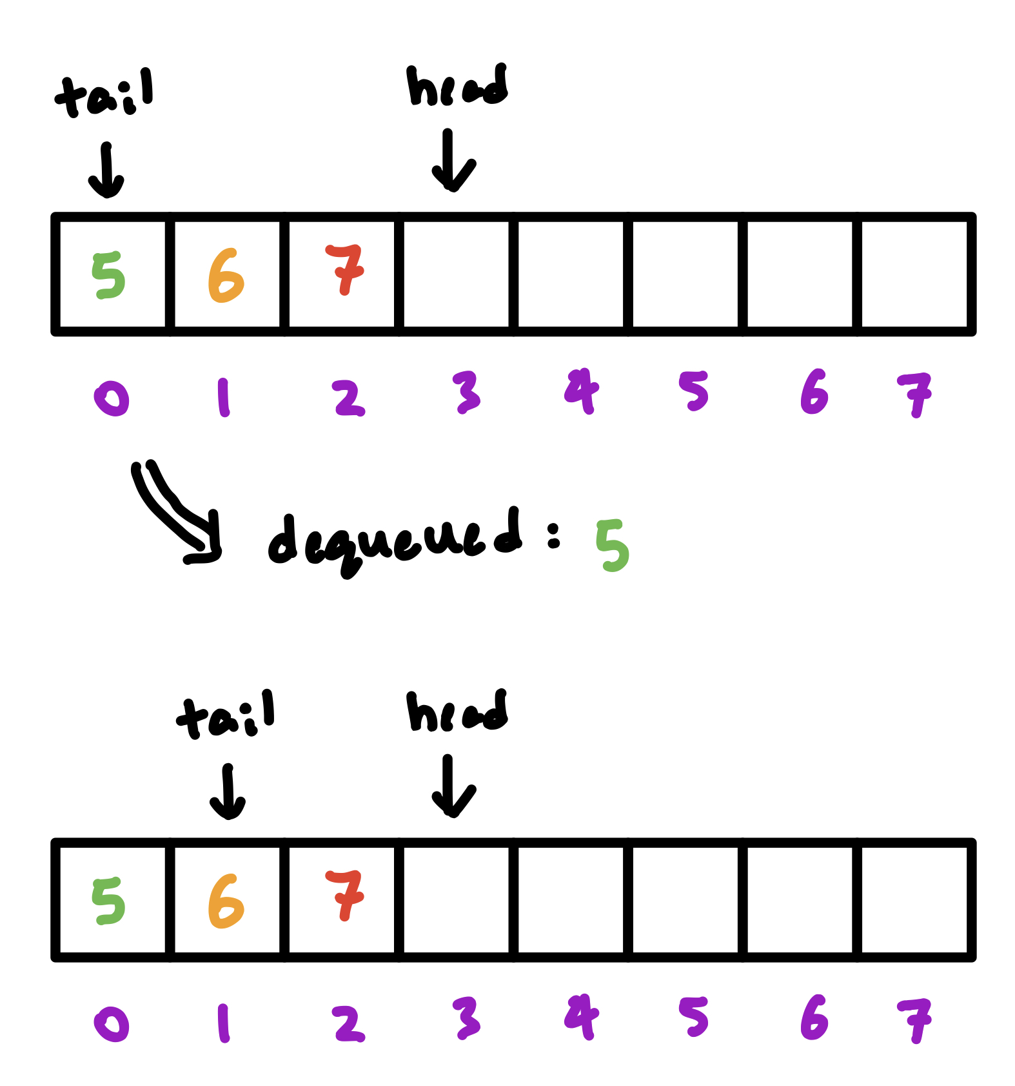
Example: Dequeuing items
Pass back the item at the tail, move the tail forward.

Slide 29
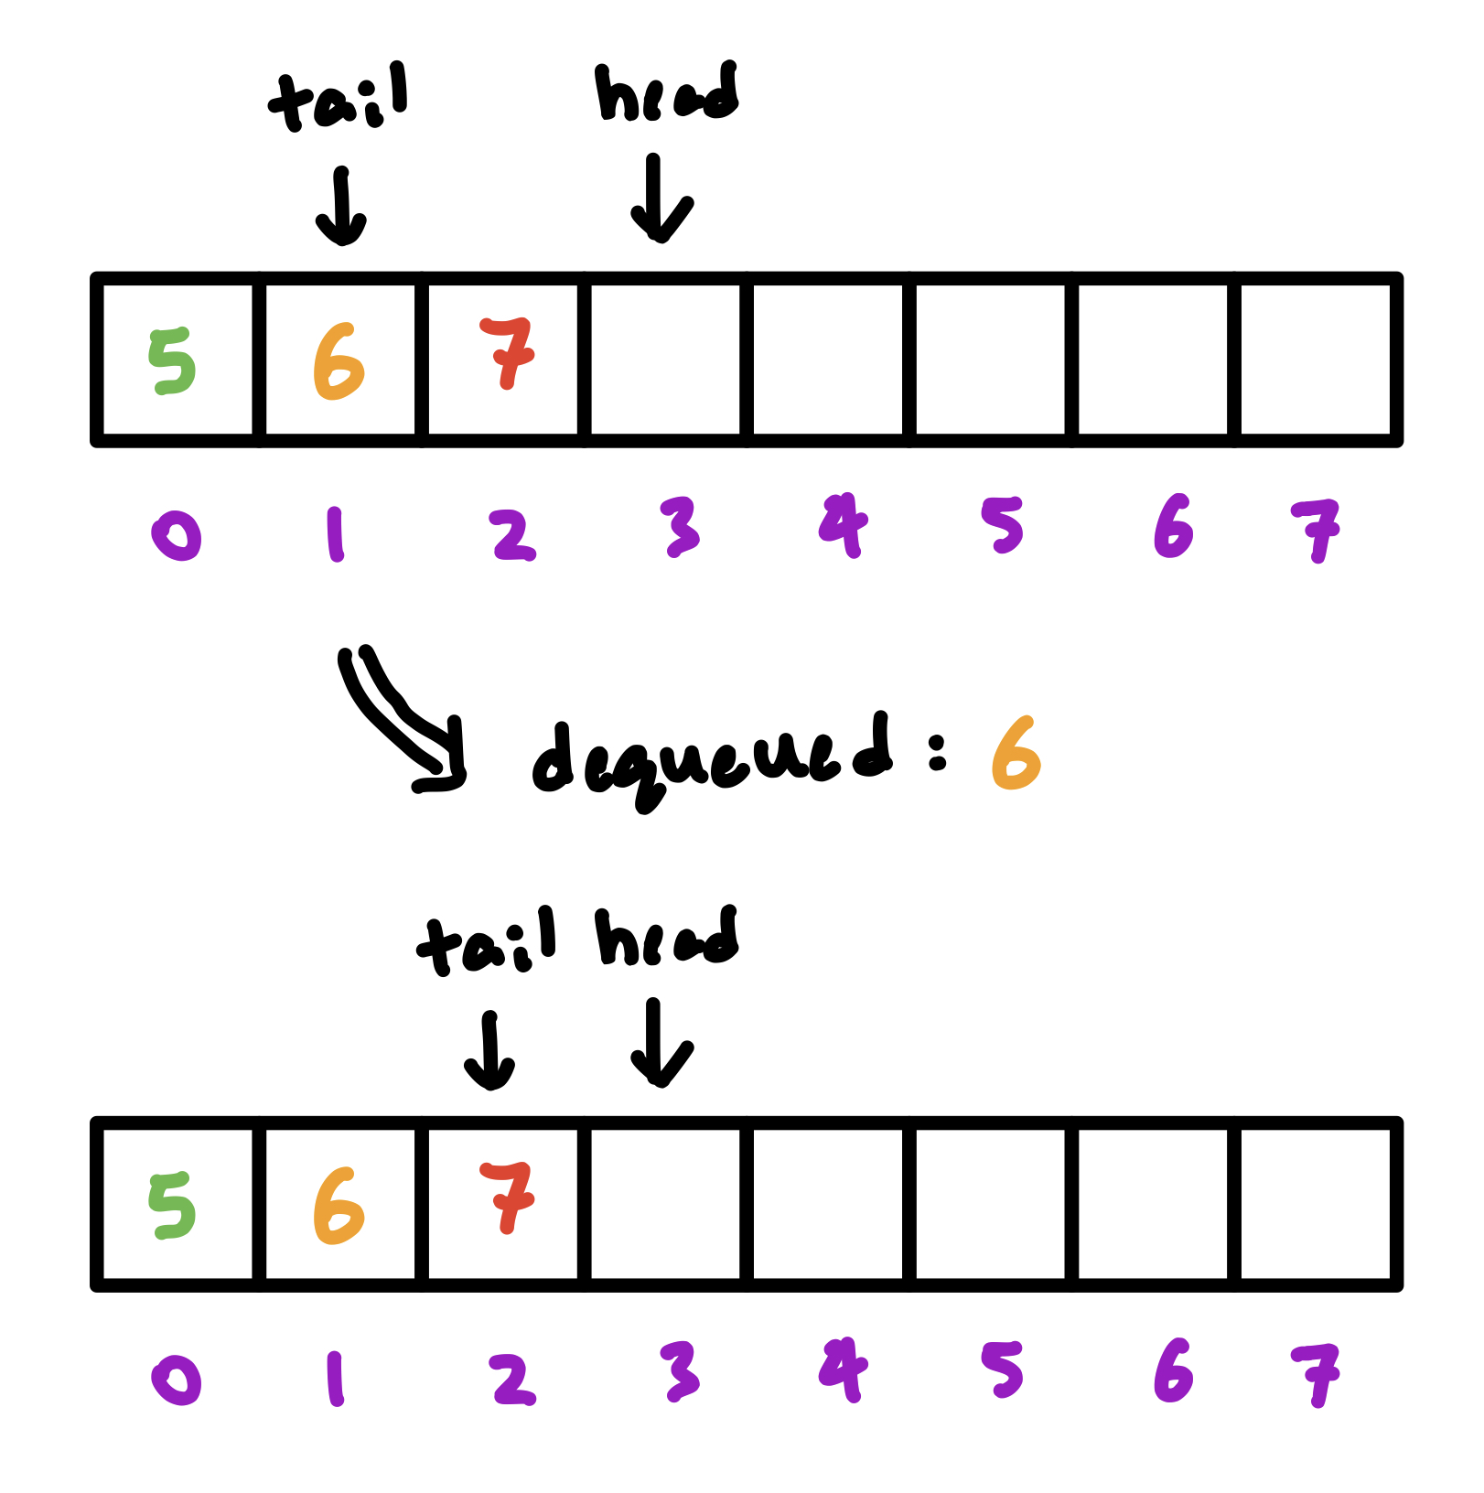
Example: Dequeuing items
Pass back the item at the tail, move the tail forward.

Slide 30
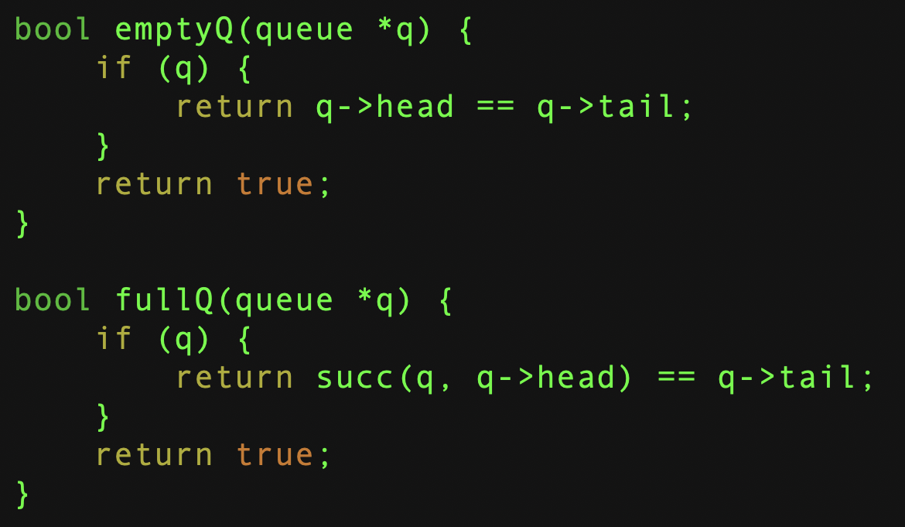
Empty? Full?
We are making a choice here:
We define an empty queue to have the head and tail indicating the same slot.
How do we define full?
We sacrifice one queue slot, and say it is full if:
head + 1 = tail (mod n)

Slide 31
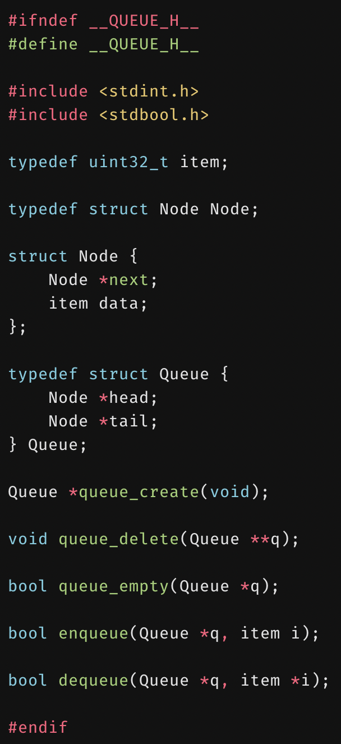
Unbounded Queues
Unbounded queues can be implemented with a linked list.
The unbounded queue itself is a wrapper for a linked list.
The wrapper keeps track of the head and tail.
© 2020 Darrell Long

Slide 32
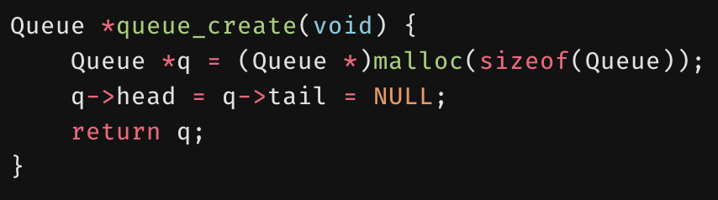
queue_create()
Both the head and tail are NULL to begin with.
© 2020 Darrell Long

Slide 33
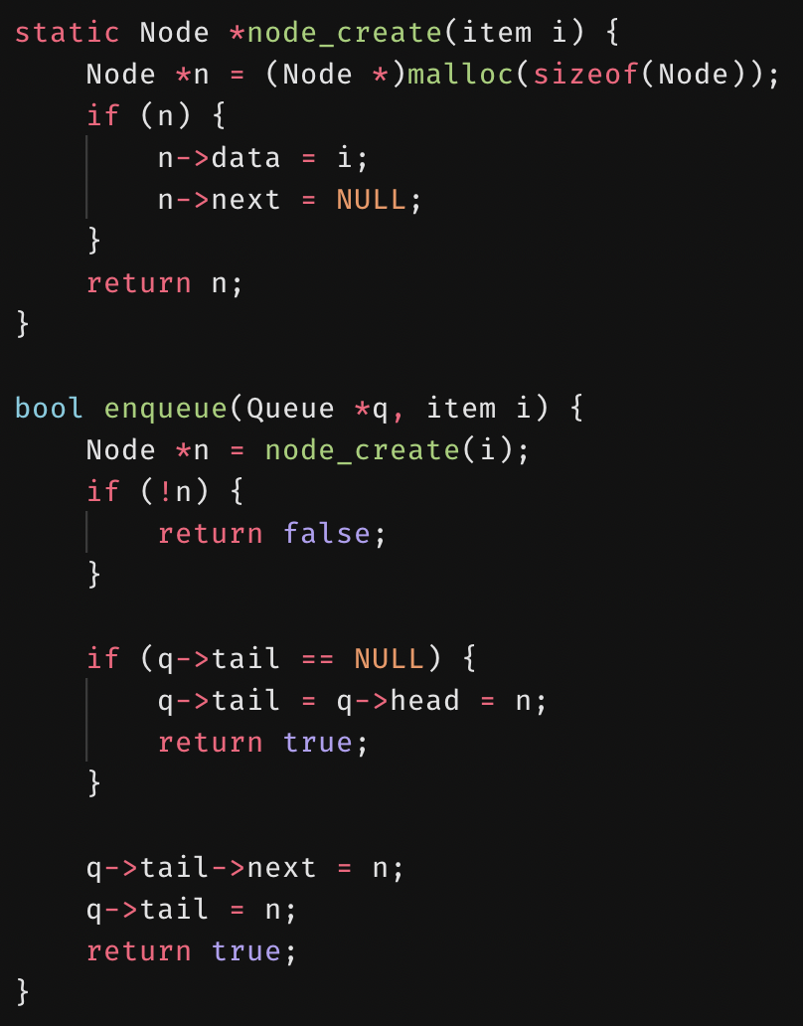
enqueue()
First, create the node to enqueue.
If the tail is NULL, then the queue is empty, and so the tail and head should be the created node.
Otherwise, add the node at the end and update the tail.
© 2020 Darrell Long

Slide 34
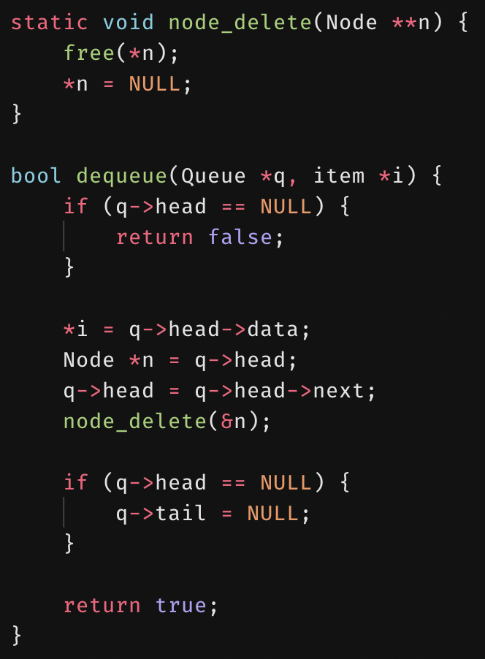
dequeue()
First, save the value of the node being dequeued.
The head of the queue is moved forward one node.
We save a pointer to it so we can free the memory it pointed to.
If the head is now NULL, then the queue is empty, and so the tail should be NULL as well.
© 2020 Darrell Long

Slide 35
Differences between stacks and queues
Removing an element:
Stack removes the most recently added element.
Queue removes the least recently added element.

Slide 36
Queue implementations
Commonly Implemented using vector-based data structures:
Arrays, linked-lists, vectors (used in C++), etc.
Some queue implementations feature an algorithm, or a rule called move-to-front:
Elements that have been previously searched for in a queue are placed at the front of the queue.
Typically used as an optimization, as the recent past is a good indicator of the near future.

Slide 37
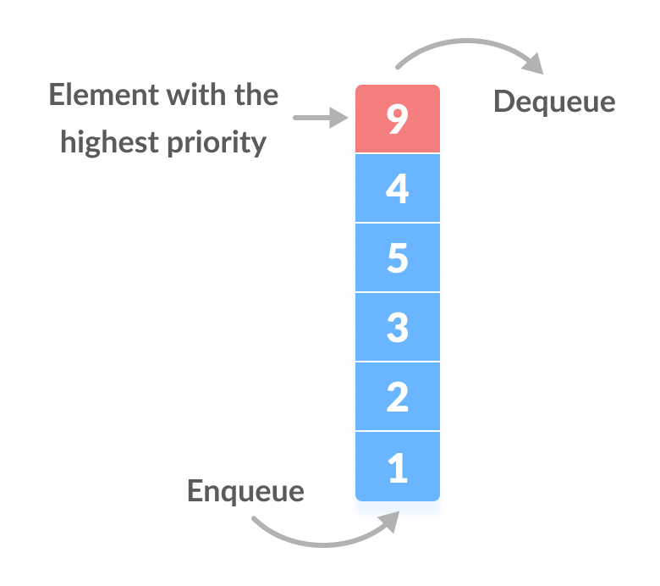
Priority Queue
Implemented like a generic queue, BUT every element has a priority associated with it.
Element of highest priority is dequeued before elements with lower priority.
In the case of two elements of the same priority, preference is given to the position of the element in the queue.

Slide 38
Summary
Stacks operate with the LIFO policy
Queues operate with the FIFO policy
Both can be implemented using basic data structures such as arrays or linked lists.

